Slide 1
Supporting Young People with Epilepsy Improving the Mental Health of Bereaved Siblings Promoting awareness and understanding of SUDEP
Registered Charity number 1189073

Slide 2
Introduction
My name is Wendy Shaw, I set up the charity, Jon Shaw Foundation in memory of my son.
On June 16 2019 my son Jon died suddenly and unexpectedly due to SUDEP. (Sudden Unexpected Death in Epilepsy) . He was diagnosed with generalised epilepsy in November 2016, having had no previous illness or seizures .
Like many other families , we had never been told of the risk of death in epilepsy, other than death through injury or drowning. We were devastated , broken and struggle every day to come to terms with our loss. He was 19 years old and at the start of his career and independent adult life.
I was and am determined to make something positive out of our loss and hopefully help other families living with epilepsy and/or bereavement. We have three main aims …

Slide 3
To promote and protect the physical and mental health of young people and the families of young people diagnosed with epilepsy in the Cheshire and West Yorkshire areas through the provision of financial assistance for equipment and services not normally provided by the statutory authorities.
There are many monitors, alarms and other safety equipment to support people living with epilepsy to manage their seizures. These can range from anti suffocation pillows and bed sensor mats to smart watches, helmets and pram security systems. This equipment can be expensive and inaccessible to many and not available on the NHS.
We hope to offer either full or partial funding for this equipment to help families and individuals living with epilepsy manage seizures, feel safe and live independently.

Slide 4
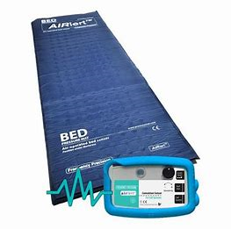
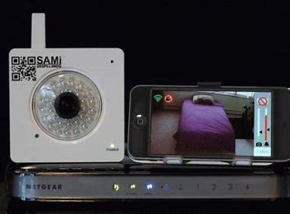
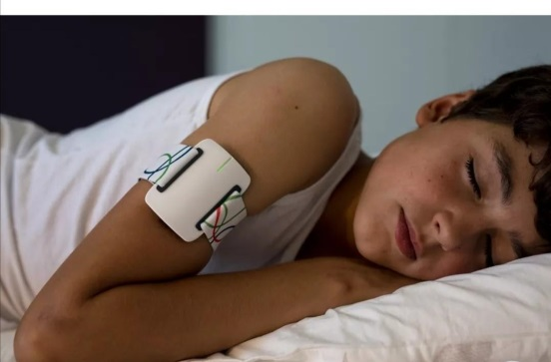
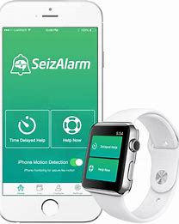
Examples of equipment
Equipment ranging from £50 - £1000₊
Pillows, smart watches, sensor pad, visual monitors all help to manage and monitor seizures providing vital records for consultations. There is no evidence to suggest they prevent SUDEP but can help to manage the risk

Slide 5
To provide support for and protect the mental health of bereaved siblings in the Cheshire and West Yorkshire areas through provision of financial assistance for activities and services not normally provided by the statutory authorities.
This is a really important part of our charity, we know from personal experience that quite often the siblings are largely forgotten when a child dies. A lot of the focus is on the parents, (particularly mum), but no matter what age the sibling has suffered a devastating loss, a brother or sister, gone forever, whether after a long illness, sudden death, accident or trauma or suicide the loss is the same.
This support would be offered on a very individual basis, depending on the needs and interests of the sibling, what would work for one may not suit another so care would be taken to work out what they would like to happen.
It would involve more personal contact with the family and time to build a relationship would be needed.
All Trustees are DBS checked.

Slide 6
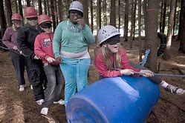
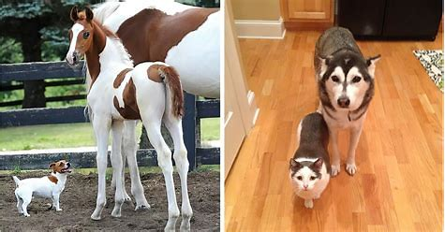
Opportunities for support
There is an endless list to the support for bereaved siblings from 1-1 counselling to less formal days out and activities with other young people in the same situation. Our vision is to have an annual event where we can all get together and try something exciting. We are working with a number of organisations so that we are ready to provide whatever the siblings need.

Slide 7
To advance the education of the general public in all areas relating to Sudden Unexpected Death in Epilepsy ( SUDEP) through promotion of the subject at fundraising events and signposting organisations specialising in SUDEP.
85% of bereaved families had never heard of SUDEP until they lost a loved one.
NICE recommends that patients are informed fully of all risks associated with epilepsy (including SUDEP) at the point of diagnosis and during follow up reviews.
There are approximately 1,000 epilepsy related deaths each year in the UK, at least 600 of these are due to SUDEP each year in the UK.
1 in every 1,000 adults and 1 in 4,500 children die through SUDEP each year
Some reports state that SUDEP is rare but traumatic, some say it is little known but not uncommon. Whichever is true SUDEP is the major cause of premature mortality in people with epilepsy.

Slide 8
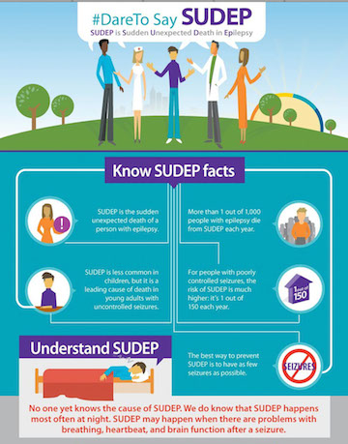
CONSIDER THIS
At least 300 babies in the UK die each year from cot death or Sudden Infant Death syndrome (SIDS).
SUDEP claims the lives of at least 600 people with epilepsy in the UK with it being the most common cause of premature death in people with epilepsy.
SIDS is widely known and openly discussed, every parent knows the risk and takes precautions to reduce it.
SUDEP is a little known cause of death, organisations and agencies including Health are reluctant to talk about it, therefore removing the opportunity for parents to reduce the risk.

Slide 9
Extracts from a presentation by Rebecca Liu, Consultant Neurologist

Slide 10
by Rebecca Liu, Consultant Neurologist

Slide 11
by Rebecca Liu, Consultant Neurologist

Slide 12
by Rebecca Liu, Consultant Neurologist
GTCS = Generalised Tonic Clonic Seizures
In our experience, Jon had only suffered seizures for 3 years
He was 19 years old
He didn’t abuse alcohol, he drank but not often
His seizures were not managed well, not because he didn’t take medication but because he wasn’t aware that he’d had a seizure so couldn’t offer an accurate record to the care team. The team was aware of this .

Slide 13
by Rebecca Liu, Consultant Neurologist
AED = Anti Epileptic Drugs

Slide 14
by Rebecca Liu, Consultant Neurologist

Slide 15
by Rebecca Liu, Consultant Neurologist

Slide 16
by Rebecca Liu, Consultant Neurologist

Slide 17
by Rebecca Liu, Consultant Neurologist

Slide 18
by Rebecca Liu, Consultant Neurologist
PWE = People with Epilepsy

Slide 19
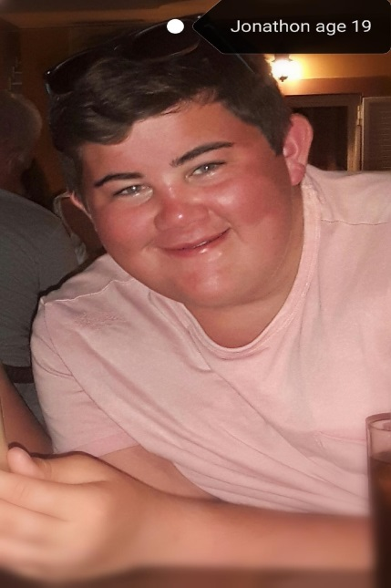
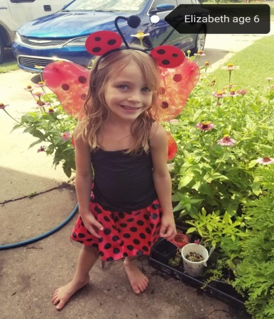
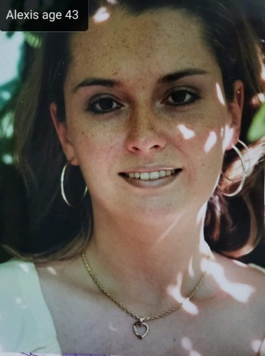
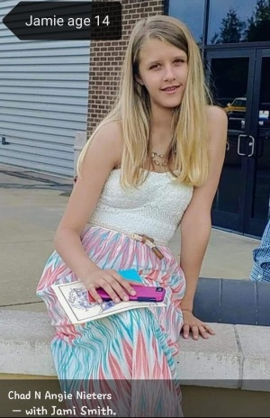
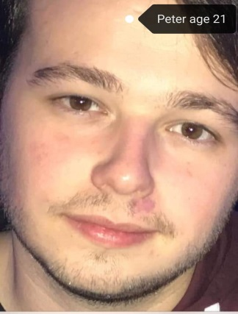
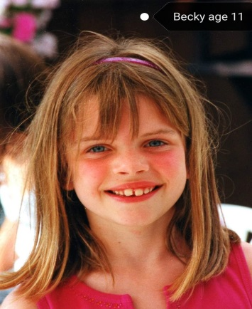
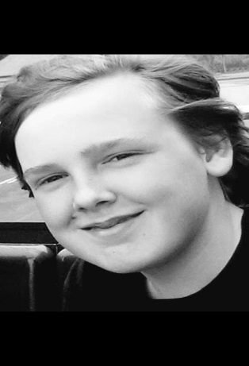
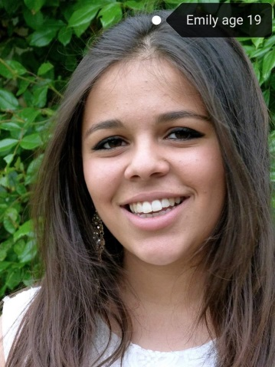
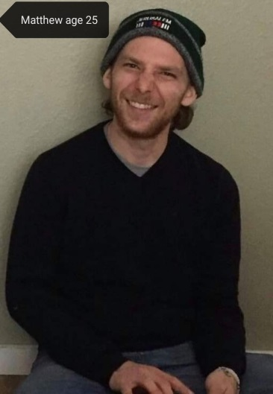
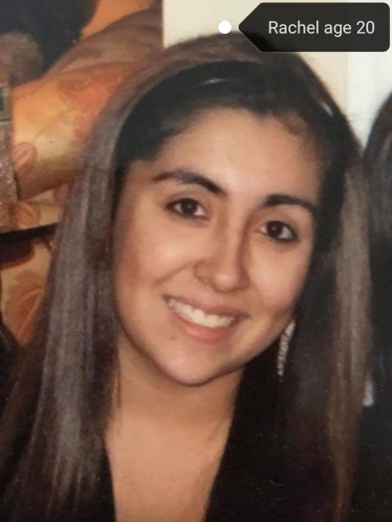
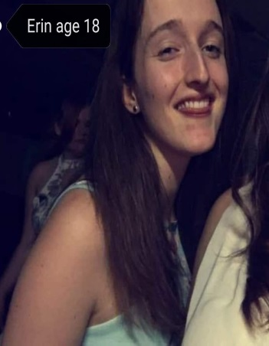
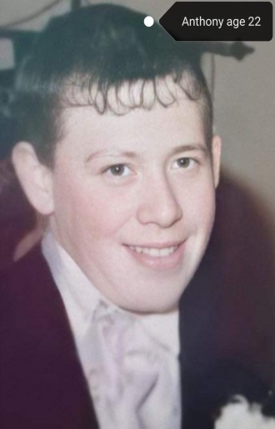
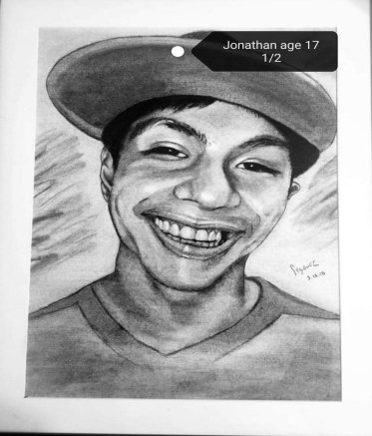
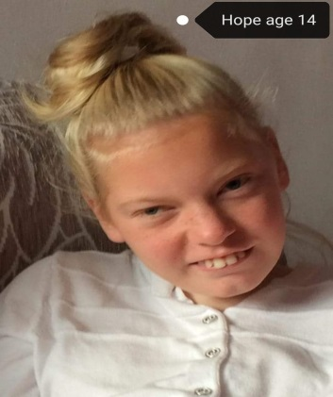
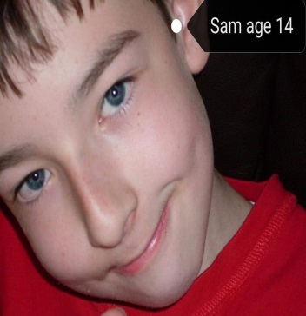
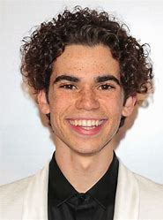
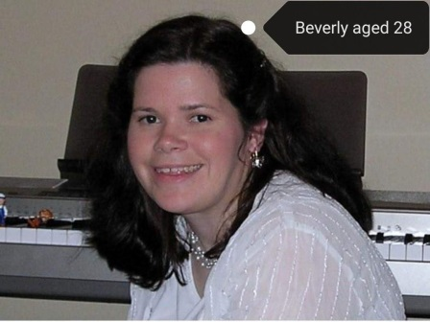
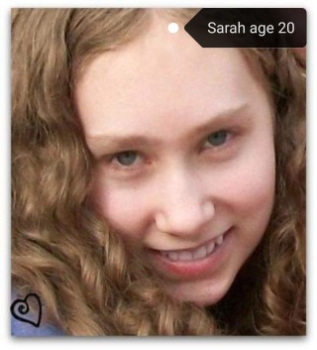
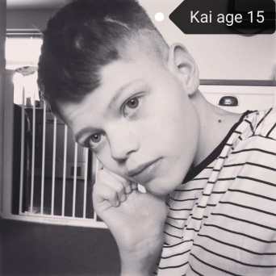
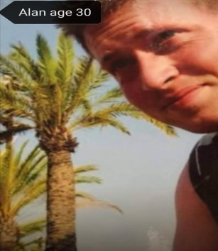
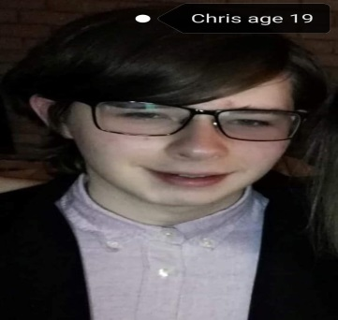
Notes:
SUDEP IS NOT JUST A STATISTIC, IT HAS CRUSHED SO MANY FAMILIES LIVES AND TAKEN SO MANY YOUNG PEOPLE FROM US

Slide 20
Next steps
To promote our charity and encourage families to contact us for support.
To begin to make a positive impact on the lives of those families living with epilepsy
Become a trusted resource, available to support our bereaved siblings
Continue to work with our local MP to encourage clinicians to fully share information about risks in epilepsy.

Slide 21
Sources of information and support
https://www.epilepsy.org.uk/
www.Sleepsafe.co.uk
www.sudep.org
https://www.headintothewild.co.uk/
www.jonshawfoundation.org

Slide 22
Contact us
www.jonshawfoundation.org
Email – jsf22300@gmail.com
Twitter @FoundationJon
Facebook @JonShaw19

